Slide 1
Formulas, Functions, and Global Variables

Slide 2
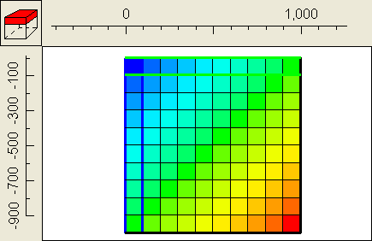
Example 1
Column + Row

Slide 3
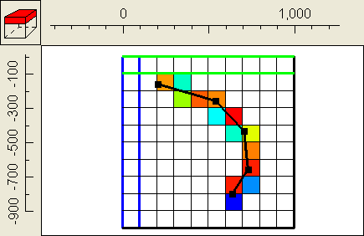
Example 2
ObjectIntersectLength

Slide 4
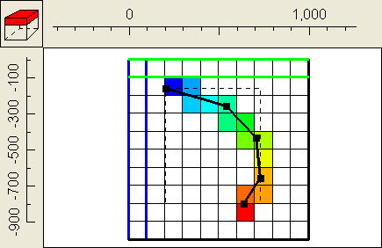
Example 3
Interpolate(FractionOfObjectLength, 1., 0., 2., 1.)

Slide 5
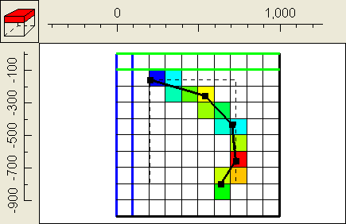
Example 4
VertexInterpolate(1, 4, 2, 5, 3)

Slide 6
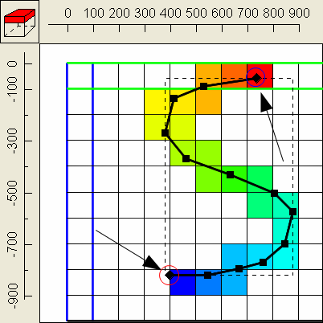
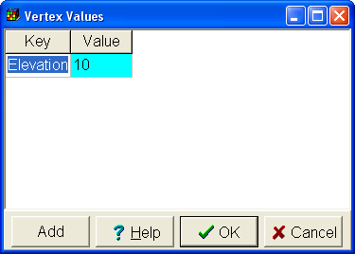
Example 5
InterpolatedVertexValue("Elevation")

Slide 7
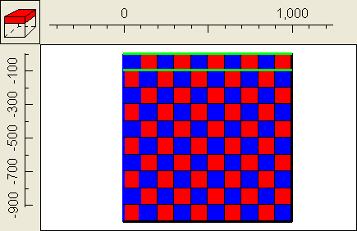
Example 6
If(Odd((Column + Row) + Layer), 1, 2)

Slide 8
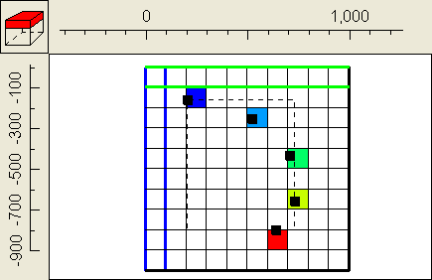
Example 7
Case(ObjectCurrentSectionIndex, 1, 2, 5, 7, 10)

Slide 9
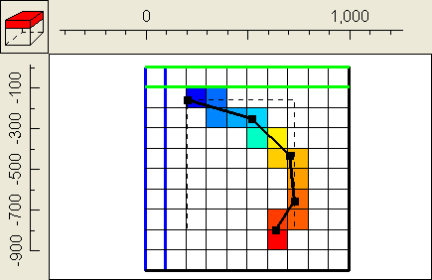
Example 8
MultiInterpolate(FractionOfObjectLength, 1., 0., 2., 0.4, 5., 0.5, 6., 1.)

Slide 10
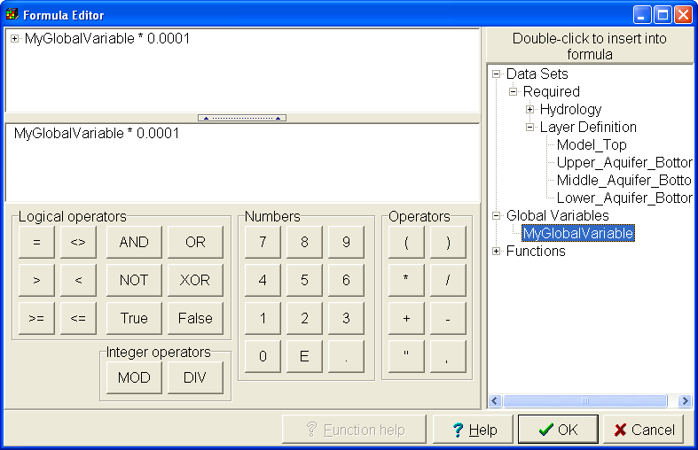
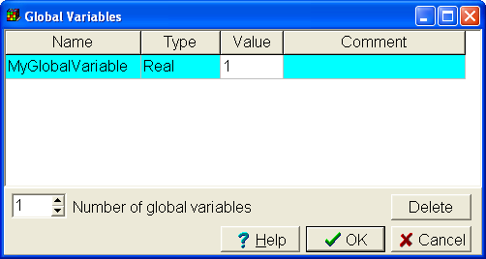
Global Variables

Slide 11
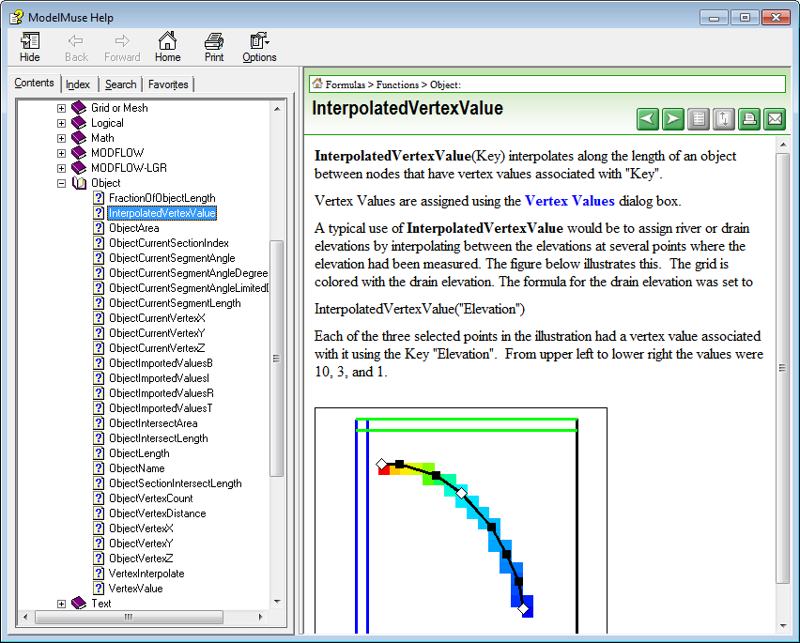
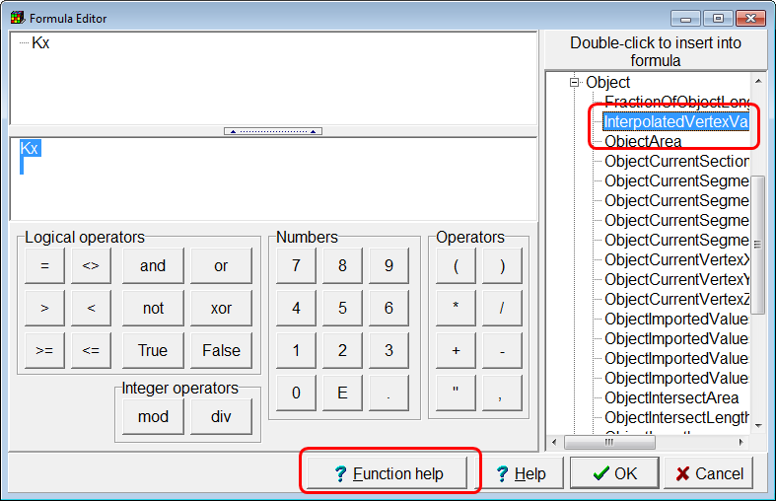
Help for Individual Functions

